Slide 1

Aerothon 2023
Design, Build and Flying Contest

Slide 2
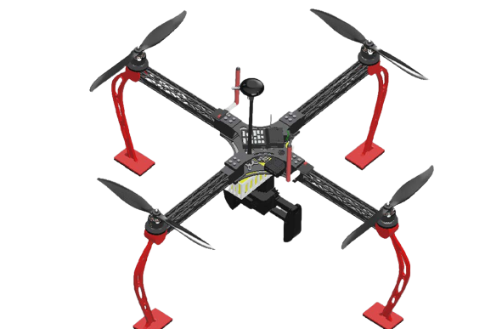

Team Name- UAV Mavericks
Team ID- AT2023-058
Collage Name- National Institute of Technology, Uttarakhand
AEROTHON-2023

Slide 3
OUTLINE OF PROJECT
01
Introduction
04
Calculations
Designing of UAV for detection and delivering.
Manual and analytical (Stablity and CFD) calculations
02
Objective
05
Result and Discussion
Create an autonomous UAV to carry payloads and locate hotspots.
Able to perform necessary simulations and designing
03
Designing
06
Refrences
Design and simulation of advanced UAV in Fusion/Ansys.
References used from books and online resources

Slide 4





APPROACH
Mar-Apr
Apr-May
May-Jun
Jul–Oct
Oct-Nov
Identified the problem and started working on a solution
Calculate the thrust and power requirement for the design
Design a high-efficiency CAD model in SOLIDWORKS
Fabricate the propeller, and different parts of Quadcopter
Assemble the parts and take a flying test
Challenge
Calculations
Designinig
Fabrication
Testing

Slide 5
Introduction
01
Project Focus: Development of a drone system for hotspot detection and precise payload delivery.
Key Capabilities: Automatic hotspot detection, target identification, and payload drop.
Purpose: Revolutionize emergency response and resource delivery in critical situations.

Slide 6
Objective
02
Create an autonomous drone system that can carry payloads and locate hotspots and target locations.
Create a mechanism for drone to safely and accurately pick up payload from specific location.
Implement advanced sensors and algorithms to enable real-time automatic hotspot detection.
Design a UAV with stable flight, autonomous capabilities, ample thrust, endurance and user-friendly control.

Slide 7
METHODOLOGY
01.
Autonomous Flight Implementation
04.
Verification and Validation
Methodology
02.
Autonomous Target Identification
03.
Precision Payload Delivery
Notes:
© Copyright Showeet.com – Creative & Free PowerPoint Templates

Slide 8
MOTIVATION
02
Benefits to Logistics and Delivery Services
Scope for Industrial and Environmental Application
Revolutionize logistics and delivery services with drones.
Broad applications of drone technology beyond hotspot detection and payload delivery.
Faster and more efficient delivery in remote or congested areas.
Industrial inspections, environmental monitoring, precision agriculture and wildlife conservation.
Enhanced customer satisfaction and reduced costs.
Notes:
© Copyright Showeet.com – Creative & Free PowerPoint Templates

Slide 9
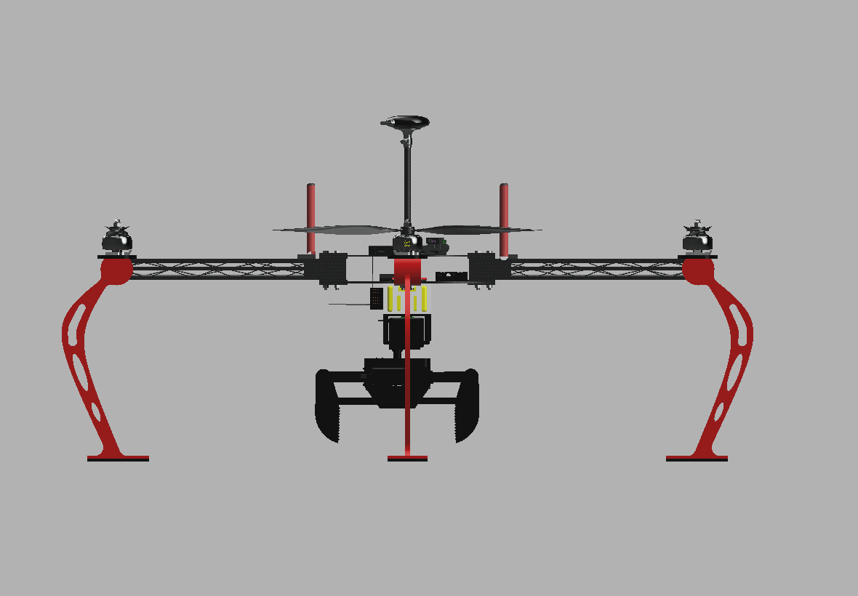

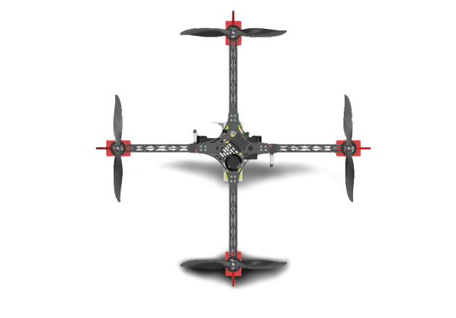
Conceptual Design
03

Slide 10
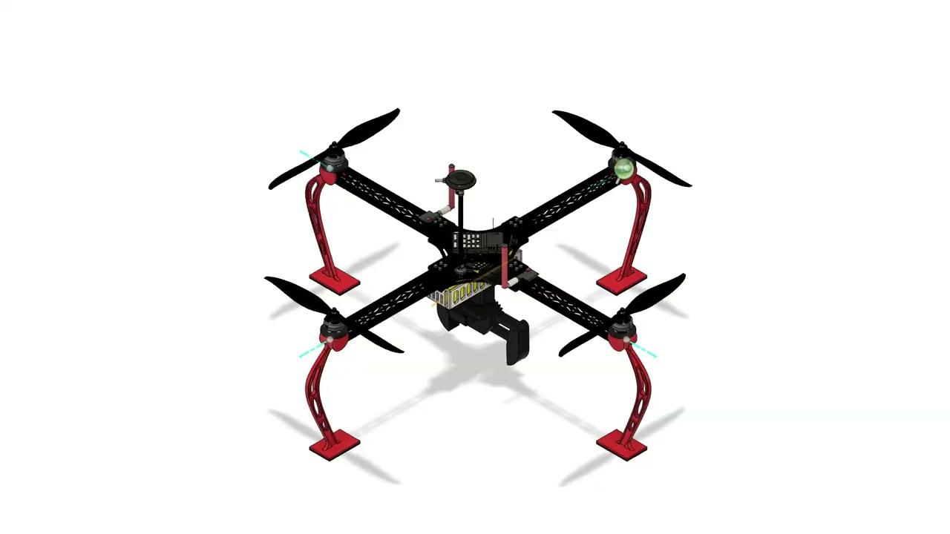
ANIMATION VIDEO
03

Slide 11
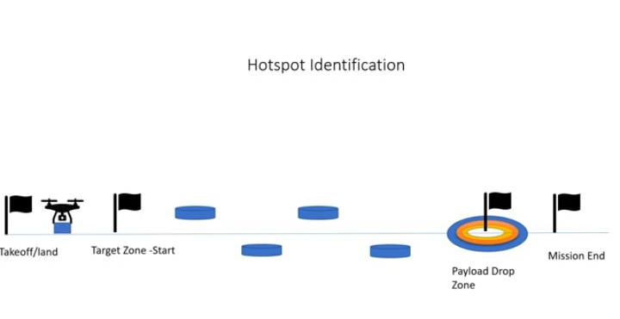
WORKFLOW SIMULATION
03
https://drive.google.com/file/d/1QjHDIYTP1a7uzYMKWxu7CO7OnIdI0SL8/view?usp=drivesdk

Slide 12
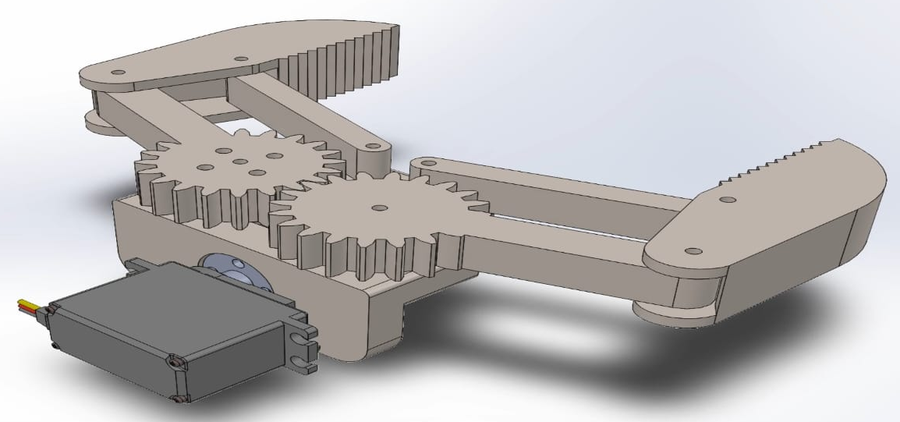
CLAW MECHANISM
03
https://drive.google.com/file/d/1BA0iJyru3hr_wGSpqvBqI95l_qe9BmO2/view?usp=drivesdk

Slide 13
Material/Parts Selection
03
Formers: They are the basic structural members and will be responsible for the structure’s stability. Gray Cast Iron was chosen for the formers because of its high strength properties. This provides extra strength to withstand the stresses and pressure at given operating condition
Body: The body consists of the outer shell of the monocoque structure, the wings and the tails. This was made up of carbon fiber (Hexcel AS4C) for providing structural strength as well as to minimize the weight of the UAV.
UAV Propeller: Generally, the propulsive system of a multi-rotor UAV is focally depended upon its propeller. The glass and carbon fibers-based propellers are drastically used in UAVs because of their advanced properties. The stiffness to weight ratio is quite high in the polymer matrix composite, which is able to provide better performance at critical phases such as high forward and vertical speed conditions, high gust load environments, and large endurance applications.

Slide 14
Materials/Parts
03
C: Consumable NC: Non Consumable
S.NO | COMPONENT | TYPE | QUANTITY
1 | CF Rods 24mm 1mtr | C | 2
2 | CF Sheet 40*40 cm | C | 2
3 | 1300kv Emax ECOII 2807 | NC | 6
4 | Holybro 4 in 1 60 am ESC | NC | 1
5 | Holybro pixhaw6C + GPS | NC | 1
6 | Pixhawk I2C | NC | 2
7 | FSI TH9X receiver and transmitter | NC | 1
8 | ABS Propeller | C | 8
9 | Mini telemetry kit | NC | 1
10 | Landing Pad | NC | 1
11 | Propeller release tool | NC | 1
12 | Motor vibration Pad | NC | 1

Slide 15
Materials/Parts
03
S.NO | COMPONENT | TYPE | QUANTITY
13 | Pixhawk shock absorber | NC | 1
14 | Li-Po battery 6000 mah | NC | 3
15 | Power distribution board | C | 1
16 | Li-po battery 1800mh 3s | NC | 1
17 | Battery Voltage Protector | C | 1
18 | Strap | C | 4
19 | Battery protector | C | 4
20 | Charging board | NC | 1
21 | Battery charger | NC | 1
22 | Male connector | C | 6
23 | Female connector | C | 6
24 | Bullet connector | C | 12

Slide 16
Materials/Parts
03
S.NO | COMPONENT | TYPE | QUANTITY
25 | XT60 connector | C | 1
26 | Switch | C | 1
27 | Silicon wire 1m | C | 2
28 | Heat shrink | C | 1
29 | Zip ties 100mm | C | 1
30 | Zip ties 350mm | C | 1
31 | Jumper connector | C | 1
32 | Jumper wire | C | 1
33 | Proximity sensor | NC | 8
34 | Distance sensor | NC | 1
35 | Landing gear | NC | 4
36 | Carbon Fiber Propeller | C | 4

Slide 17
Estimated Weight of Components
04
Major Component | Weight ( in gms ) | Major Component | Weight ( in gms )
Frame | 482 | Camera | 18.361
Motor | 32*4 = 128 | Camera Transmitter | 20.5
Propeller | 23*4 = 92 | Signal Receiver | 15.559
Landing Gear | 172 | GPS | 92.036
Pickup Mechanism | 106.808 | Power Module | 30.139
Battery | 515 | Telemetry | 9.132
ESC | 14 | Other Components | 68.9
Flight Controller | 59.724 | Camera | 18.361
Total |  |  | 1816

Slide 18
Thrust Estimation
04
Drone estimated weight is taken as 2050 gms (2 kg) including the payload. A total of 2050 (2 kg) gms or greater thrust is required. The model was generated and tested by the team using simulation came out to withstand the thrust required with the proper use of the propellers.
Estimated Weight Of Drone Including Payload = 2100 gms, means;
Minimum Thrust Required for Takeoff = 2100 gms
Thrust Required to be generated by each motor = 2100/4 gms = 525 gms

Slide 19
Electric Propulsion System
04
Efficiency : Electric propulsion system is more energy efficient than conventional internal combustion engines
Emissions Reductions: Electric propulsion system operate with zero direct emissions, while combustion engines produces greenhouse gases and other pollutants. They contribute to greener, cleaner transportation
Improved Maneuverability: Electric propulsion systems provide precise thrust control, enabling rapid
changes in speed and direction.
Simplified Maintenance: Maintenance is simplified since there are fewer moving parts in electric propulsion systems than there are in combustion engines. They eliminate the need for fuel management, spark plug replacement, and oil changes.

Slide 20
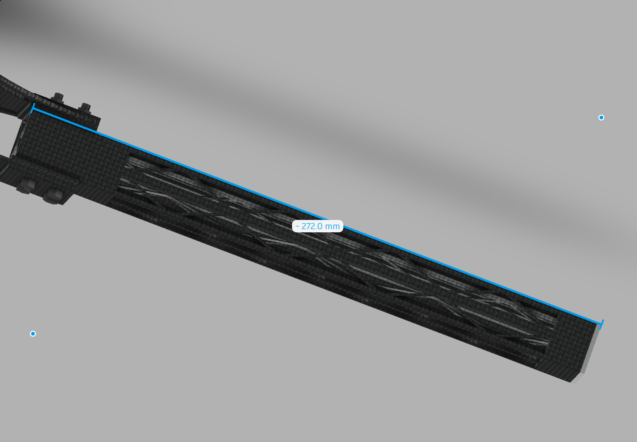
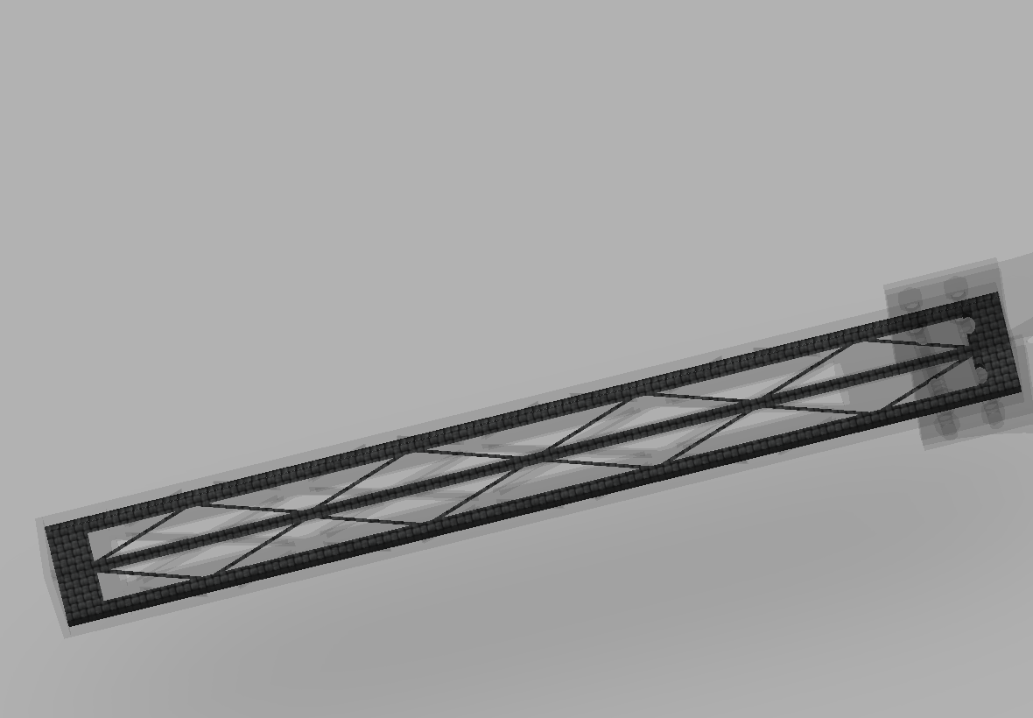
UAV Sizing (Rotor Arm)
04
The Rotor Arm is the one on which the motor is mounted.
Drone has arm length of 272 mm.
This makes proper clearance for the propellers.
Its is made of carbon fiber with engraved pattern to make it light weight and make it more flexible.
The internal hollow is supported by pattern representing trusses. It helps to support the arm against forces from all direction and provides extra strength.

Slide 21
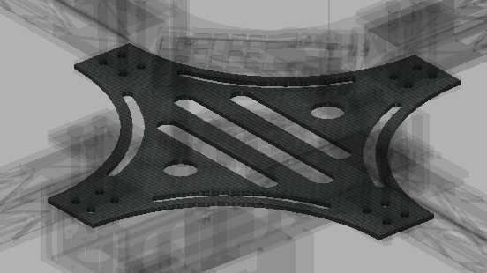
UAV Sizing (Hub)
04
A hub in a drone typically refers to a central component that supports various subsystems or components within the drone. It acts as a central unit of the drone.
Drone has a hub size of 200 mm.

Slide 22
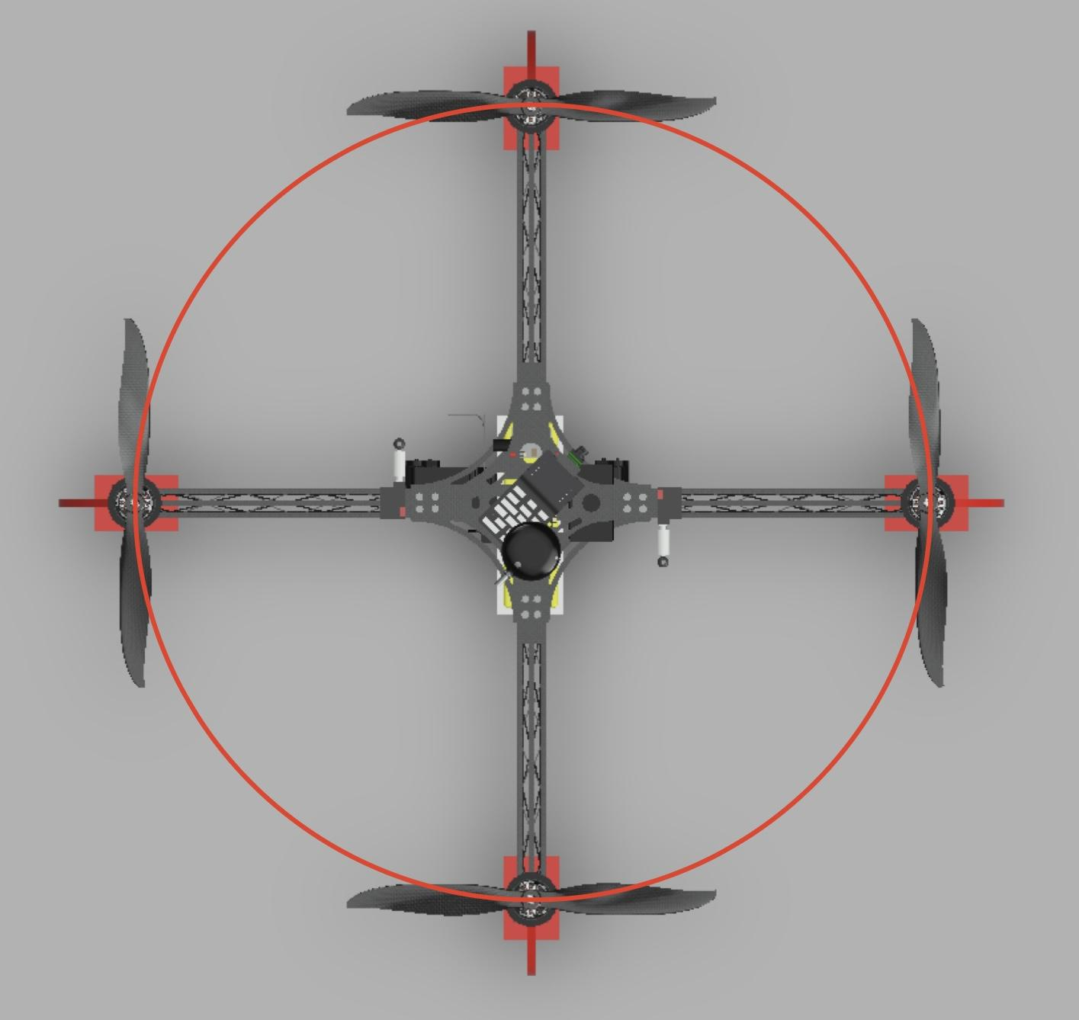
UAV Sizing (Wheelbase)
04
Boundary Condition
Attributes | Values
Height | 392.865 mm
Length | 787.276 mm
Width | 787.276 mm

Slide 23
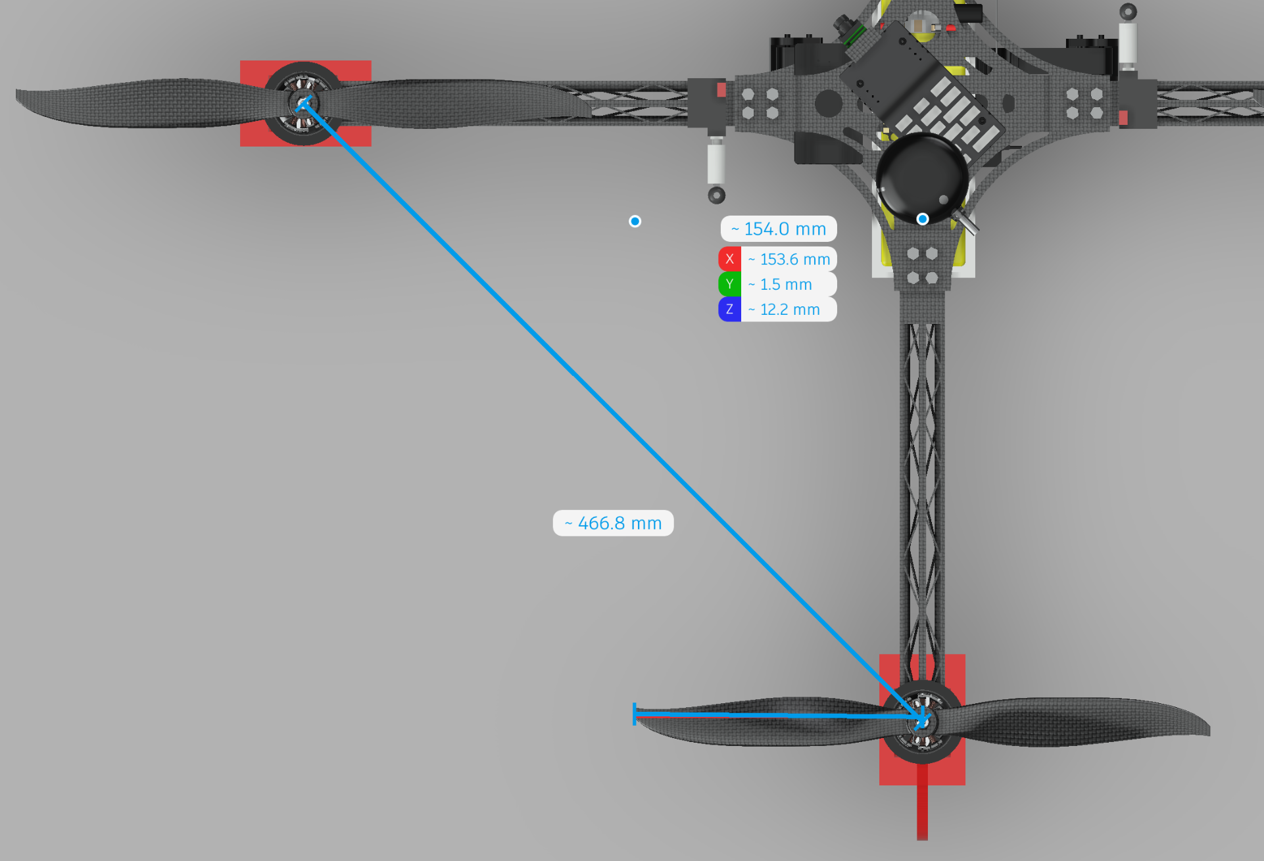
UAV Sizing (Propeller Clearance)
04
Propeller: 12 * 45
Propeller Size: 12 inch = 304.8mm
Distance between 2 adjacent propeller = 466.8 mm
Clearance = 158 mm

Slide 24
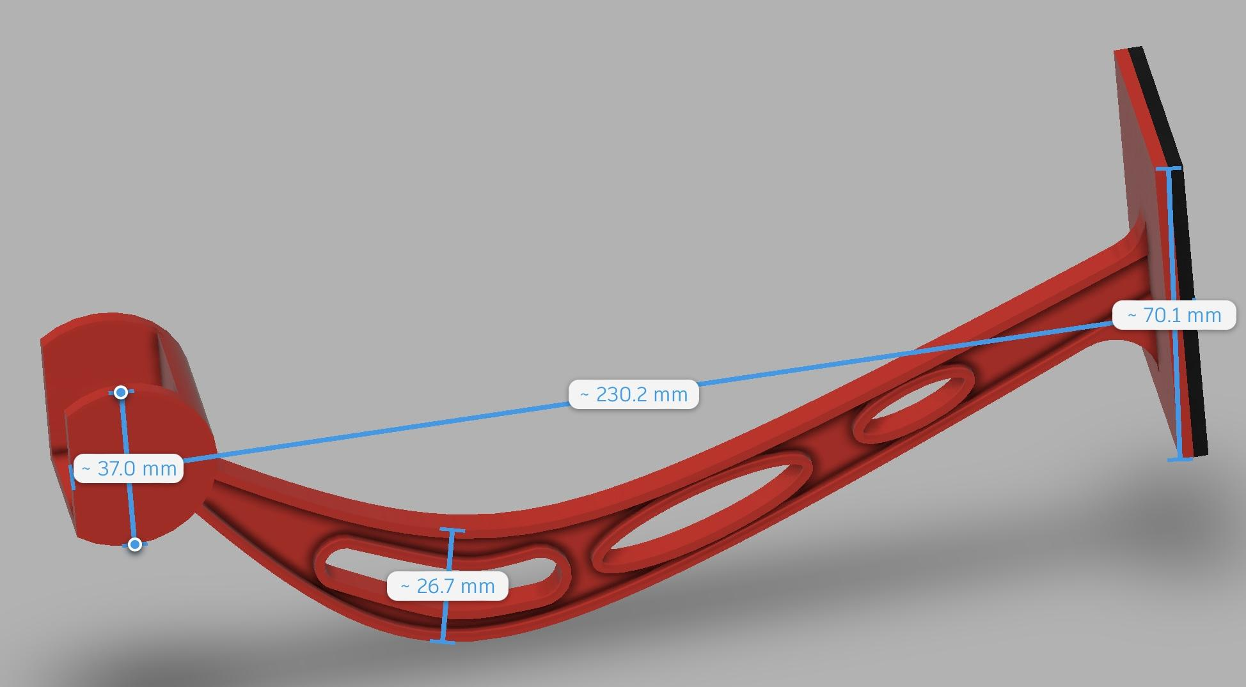
UAV Sizing (Landing Gear)
04
3D Printed Landing gear with rubber padding at the bottom to support shock during landing.
It is shaped in an arc structure to eliminate shock force.
The landing gear would support the frame away from ground.
It would also help the electronic components from damage.

Slide 25
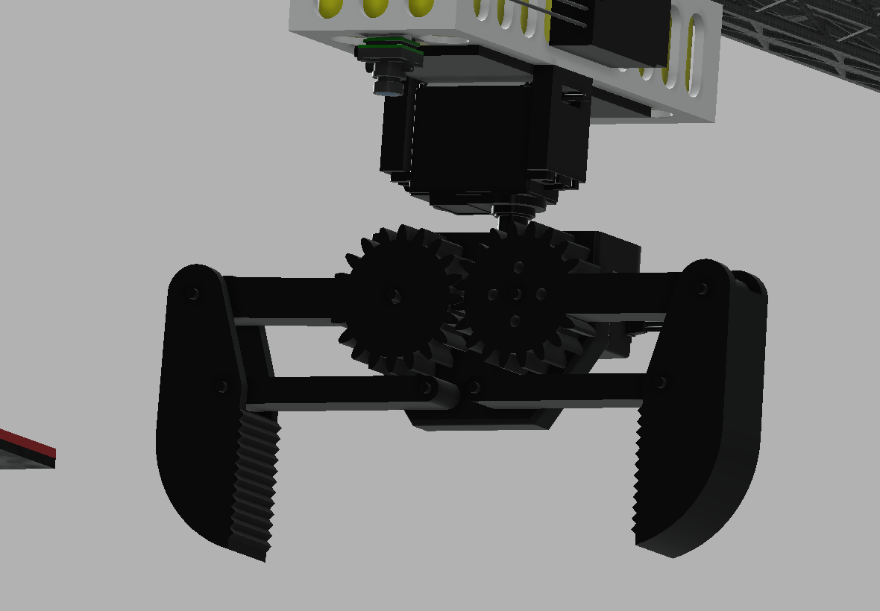
Pickup Mechanism
04
Claw Mechanism System is being used here with two axis rotation capability.
The claw is served with two servo motors. One operates the opening and closing of claw and other for the rotational movement of the claw in XY Plane.

Slide 26
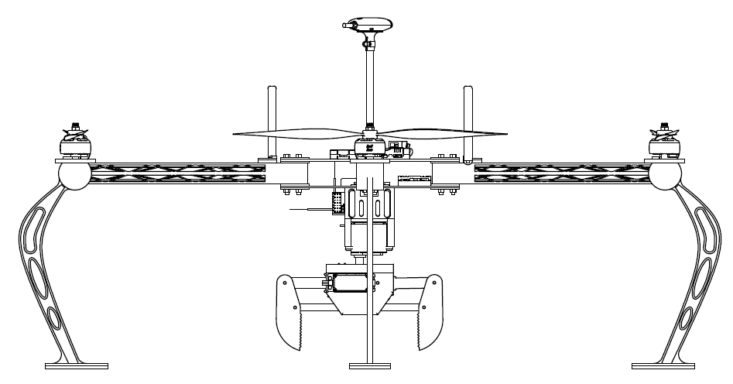
CAD Model (2-D)
04
FRONT VIEW

Slide 27
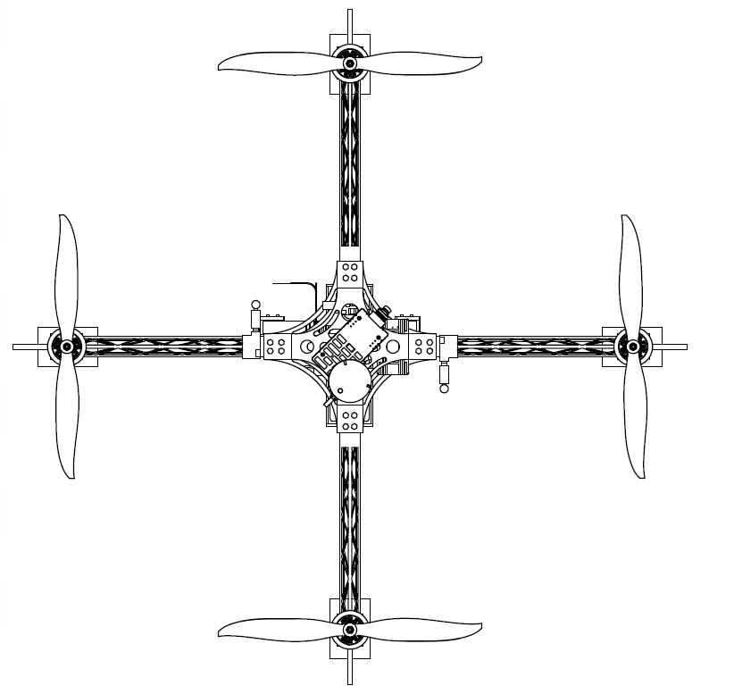
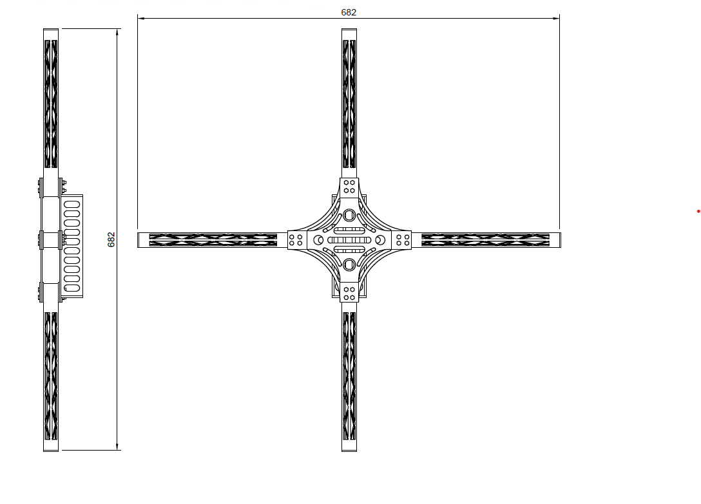
CAD Model (2-D)
04
TOP VIEW
SIDE VIEW

Slide 28
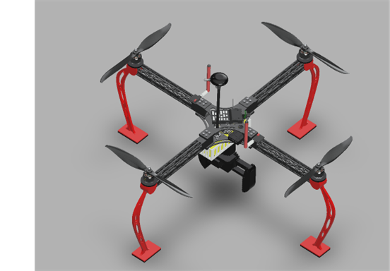
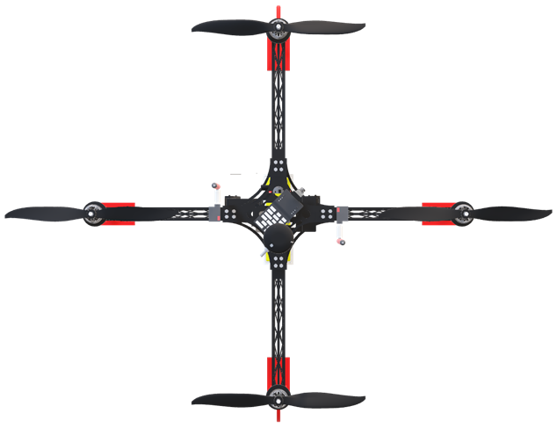
CAD Model (3-D)
04

Slide 29
Aircraft Performance
04
Power Required Estimation
Case 1: Max Load at Motor |  | Case 2: Min Load at Motor
Specification | Value | Specification | Value
Current | 52 A | Current | 4.75 A
Voltage | 12.53 V | Voltage | 14.59 V
Revolutions | 15360 rpm | Revolutions | 4648 rpm
Electrical Power | 651.56 W | Electrical Power | 69.4 W

Slide 30
Aircraft Performance
04
Power System Selection
Specification | Value
Name | Lithium Polymer Battery
Cell Count | 4
Voltage Per Cell | 3.7 volts
Total Voltage | 14.8 volts
Capacity | 8000 mAh
Discharge Rate | 35 C
Current drawn = C-rate of battery * Capacity of Battery
= 35 * 8 = 280 A
Rated Energy Stored = Voltage * Capacity
= 14.8 * 8
= 118.4 W-h

Slide 31
Aircraft Performance
04
Endurance Estimation
Average Amp Draw = Weight at takeoff in kg × Power (assume 220 W) / Volts
= 2 * 220 / 14.8
= 29.72 Amp
Run Time = Capacity in Ah * discharge % * 60 / Average Amp Draw
= 8 * 35 * 60 / 30
= 12.8 min
Range = ( Kv * Volt * 60 * Pitch * Run Time in hrs *1.6 ) / ( 12 * 5260) km
= ( 1300 * 14.8 * 60 * 4.5 * 12.8/60 *1.6 ) / (12 * 5260 )
= 28.09 km

Slide 32
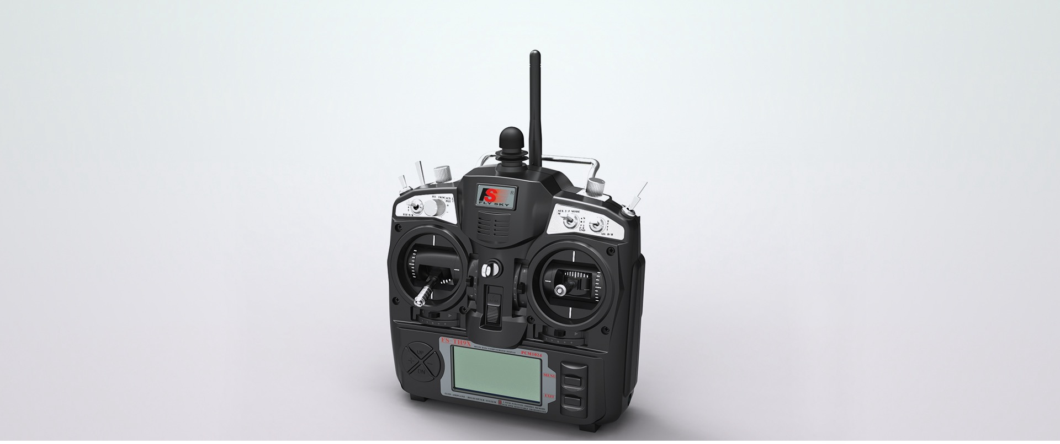
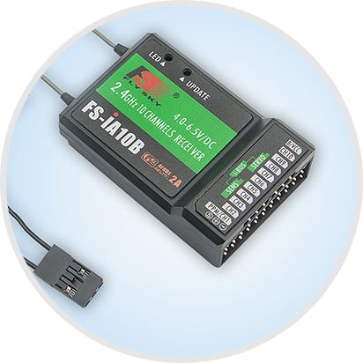
Communication System
04
Transmitter Name: FS-TH9X
Channels Supported :14
Wireless frequency: 2.4GHz
Wireless protocol: AFHDS 2A
Range: 500 ～ 1500m (in the air)
Receiver Supported: FS iA108
Antenna type: external single antenna
Weight: 690g

Slide 33
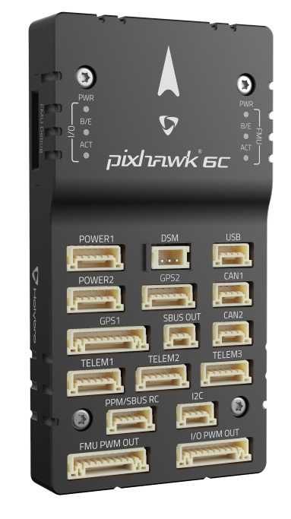
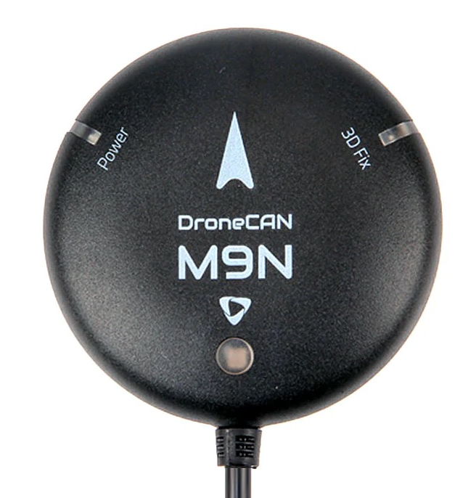
Control and Navigation System
05
Flight Controller | Pixhawk 6C
Clock Speed | 480 MHz
Processor | STM32H743
IO Processor | STM32f103
Signal Support Type | PWM

Slide 34
Center of Gravity Estimation
05
Mass = 1.15 kilograms |  |  | Surface area = 938462.73 square millimeters
Center of mass: (millimeters) |  | X = 1.74,, Y = 4.20, Z = -62.25
Moments of inertia (kilograms*square millimeters) |  |  |  | Principal moments of inertia ( kilograma*square millimeters)
Taken at the center of mass and aligned with the output coordinate system |  | Taken at the output coordinate system |  | Taken at the center of mass
Lxx = 28873.22 | Lxy = -81.69 | Ixx = 33342.43 | Ixy = -90.09 | Ix = (-0.10, 1.00, -0.02) | Px = 27978.89
Lyx = -81.69 | Lyy = 27990.14 | Iyx = -90.09 | Iyy = 33342.43 | Iy = (-1.00, -0.10, -0.02) | Py = 28877.08
Lzx = 248.71 | Lzy = -216.25 | Izx = 373.14 | Izy = -516.60 | Iz = (-0.02, 0.01, 1.00) | Pz = 43105.61

Slide 35
Stability Analysis
05
Load Case 1:
Name | Minimum | Maximum | Name | Minimum | Maximum
Safety Factor |  |  | Shear YZ | -16.86 MPa | 16.23 MPa
Safety Factor (Per Body) | 5.447 | 15 | Shear ZX | -23.1 MPa | 19.2 MPa
Stress |  |  | Displacement
Von Mises | 6.185E-09 MPa | 55.08 MPa | Total | 0 mm | 0.2058 mm
1st Principal | -39.2 MPa | 89.41 MPa | X | -0.01133 mm | 0.01447 mm
3rd Principal | -60.3 MPa | 30.94 MPa | Y | -0.01478 mm | 0.01538 mm
Normal XX | -46.17 MPa | 87.06 MPa | Z | -0.0609 mm | 0.2051 mm
Normal YY | -55.83 MPa | 49.19 MPa | Reaction Force
Normal ZZ | -48.72 MPa | 42.71 MPa | Total | 0 N | 25.98 N
Shear XY | -21.95 MPa | 23.35 MPa | X | -9.392 N | 9.852 N

Slide 36
Stability Analysis
05
Name | Minimum | Maximum | Name | Minimum | Maximum
Y | -6.986 N | 8.881 N | Shear ZX | -4.828E-04 | 4.013E-04
Z | -25.51 N | 12.19 N | Contact Pressure
Strain |  |  | Total | 0 MPa | 34.37 MPa
Equivalent | 8.646E-14 | 7.311E-04 | X | -15.73 MPa | 15.69 MPa
1st Principal | -1.217E-05 | 6.405E-04 | Y | -25.17 MPa | 23.03 MPa
3rd Principal | -6.398E-04 | 2.046E-05 | Z | -25.02 MPa | 28.37 MPa
Normal XX | -2.866E-04 | 4.325E-04 | Contact Force
Normal YY | -2.161E-04 | 2.493E-04 | Total | 0 N | 60.81 N
Normal ZZ | -1.709E-04 | 1.863E-04 | X | -32.22 N | 37.36 N
Shear XY | -4.589E-04 | 4.881E-04 | Y | -37.53 N | 34.12 N
Shear YZ | -3.524E-04 | 3.393E-04 | Z | -48.8 N | 57.44 N

Slide 37
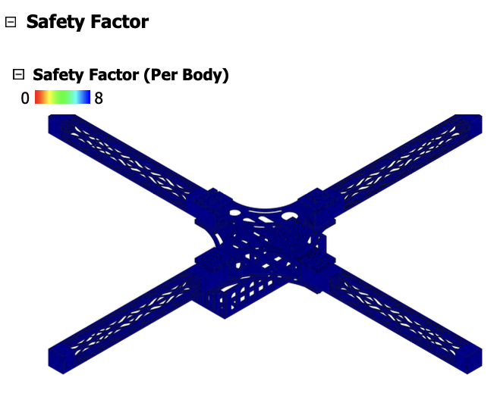
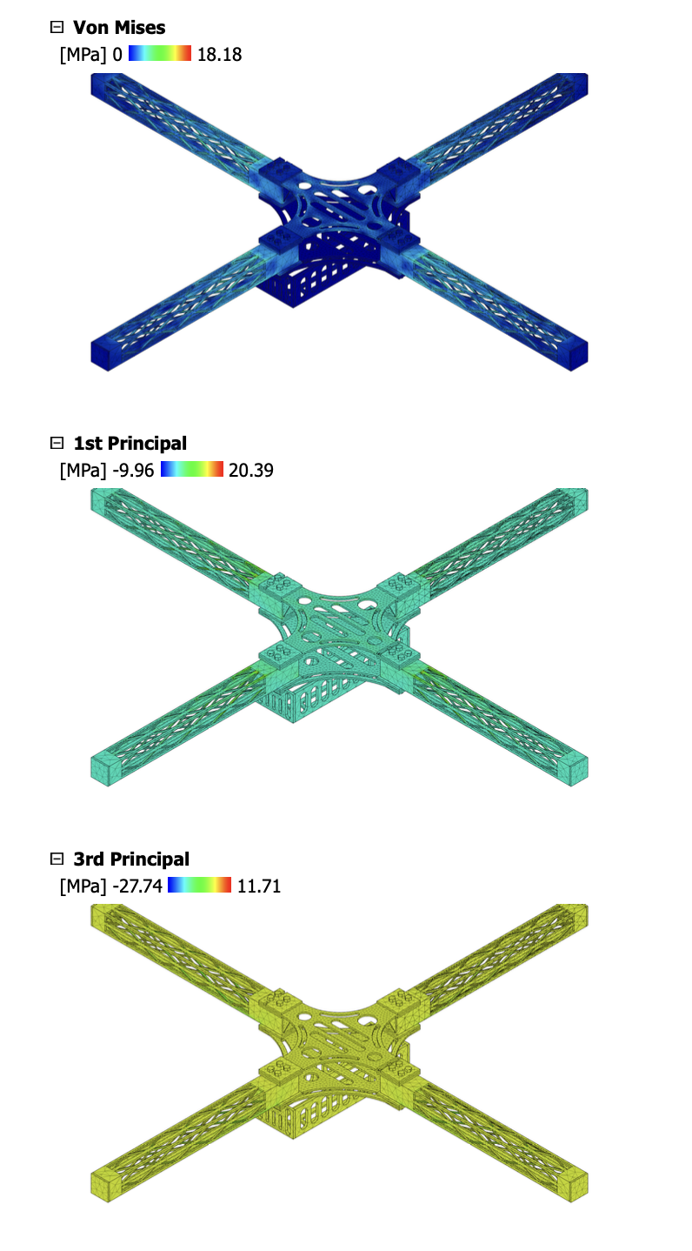
Stability Analysis
05

Slide 38
Stability Analysis
05
Load Case 2:
Name | Minimum | Maximum | Name | Minimum | Maximum
Safety Factor |  |  | Shear YZ | -9.975 MPa | 12.86 MPa
Safety Factor (Per Body) | 4.806 | 15 | Shear ZX | -21.1 MPa | 16.76 MPa
Stress |  |  | Displacement
Von Mises | 9.125E-05 MPa | 58.56 MPa | Total | 0 mm | 0.5429 mm
1st Principal | -22.53 MPa | 57.64 MPa | X | -0.3298 mm | 0.3281 mm
3rd Principal | -45.35 MPa | 28.81 MPa | Y | -0.3276 mm | 0.3357 mm
Normal XX | -31.86 MPa | 57.62 MPa | Z | -0.5428 mm | 0.005497 mm
Normal YY | -29.11 MPa | 39.85 MPa | Reaction Force
Normal ZZ | -26.12 MPa | 29.66 MPa | Total | 0 N | 0.9703 N
Shear XY | -19.16 MPa | 19.67 MPa | X | -0.3199 N | 0.3334 N

Slide 39
Stability Analysis
05
Name | Minimum | Maximum | Name | Minimum | Maximum
Y | -0.4345 N | 0.2903 N | Shear ZX | -2.52E-03 | 2.51E-03
Z | -0.2046 N | 0.943 N | Contact Pressure
Strain |  |  | Total | 0 MPa | 20.41 MPa
Equivalent | 2.29E-09 | 3.11E-03 | X | -12.17 MPa | 11.53 MPa
1st Principal | -7.12E-06 | 2.44E-03 | Y | -19.62 MPa | 15.35 MPa
3rd Principal | -3.17E-03 | 2.08E-05 | Z | -14.12 MPa | 18.01 MPa
Normal XX | -9.58E-04 | 1.22E-03 | Contact Force
Normal YY | -9.74E-04 | 1.23E-03 | Total | 0 N | 62.63 N
Normal ZZ | -1.73E-03 | 9.96E-04 | X | -27.15 N | 24.69 N
Shear XY | -7.17E-04 | 7.15E-04 | Y | -28.44 N | 31.42 N
Shear YZ | -2.53E-03 | 2.59E-03 | Z | -55.04 N | 27.74 N

Slide 40
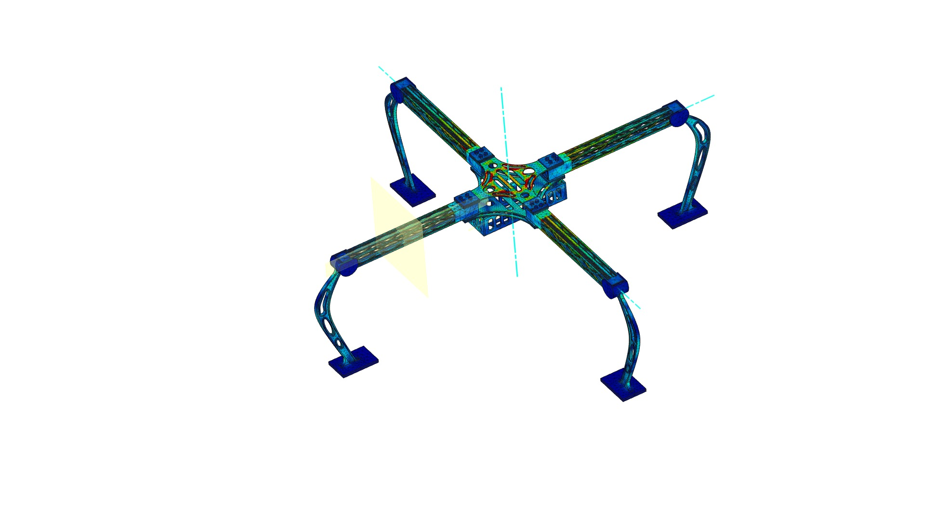
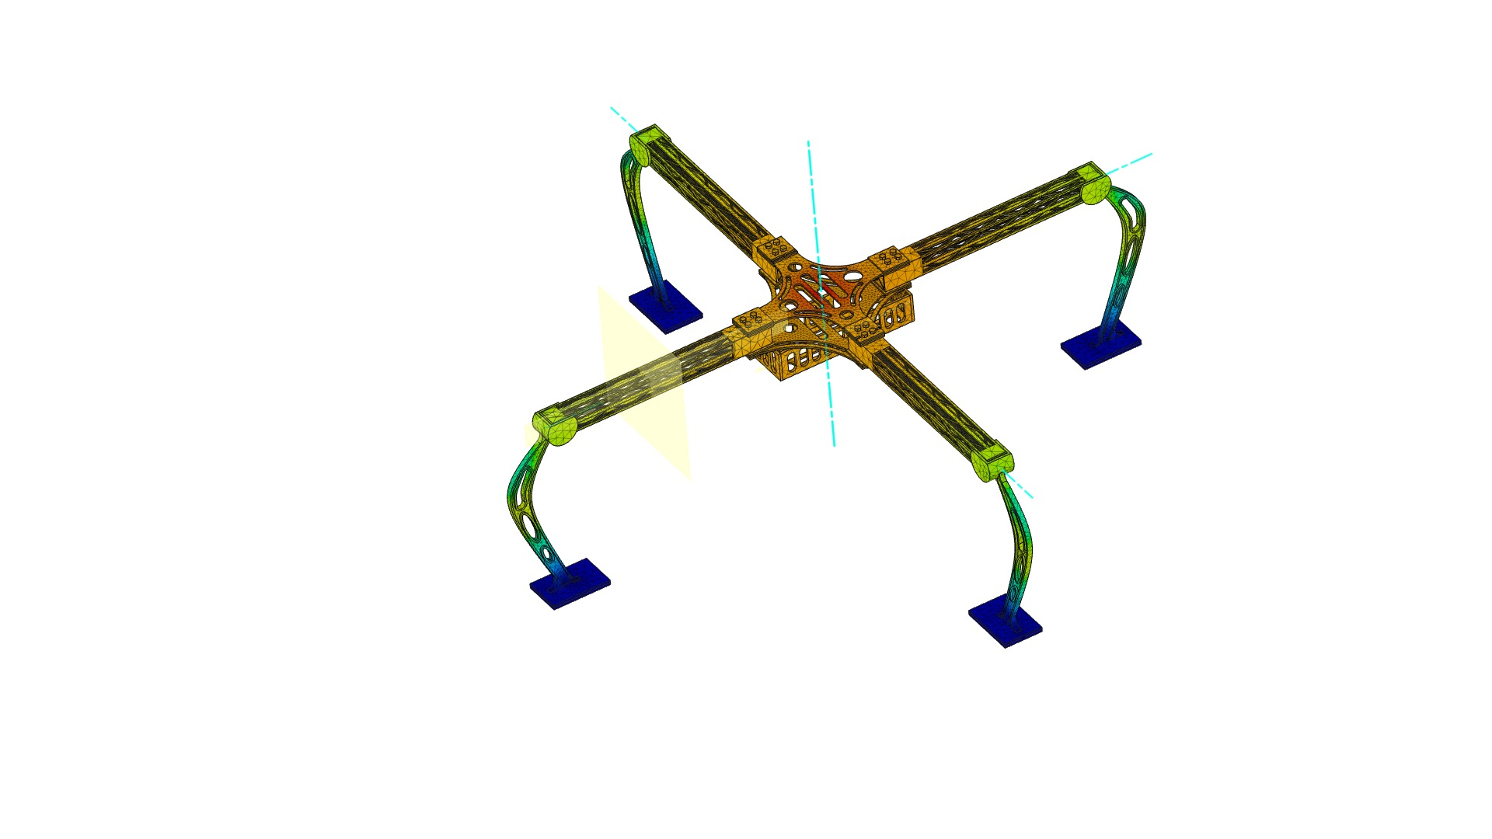
Stability Analysis
05
Stress
Displacement

Slide 41
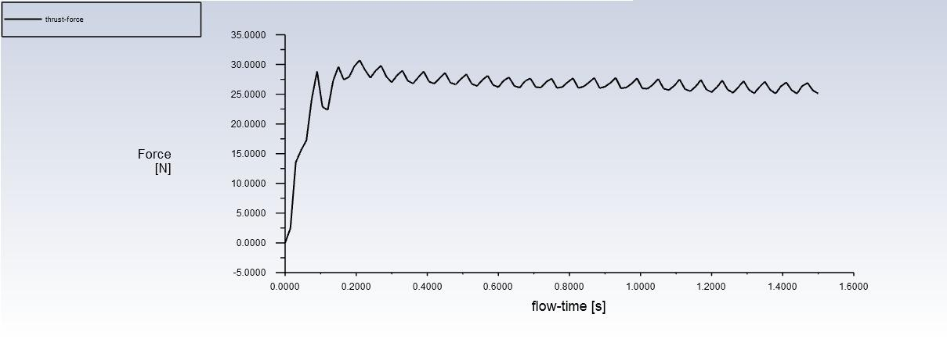
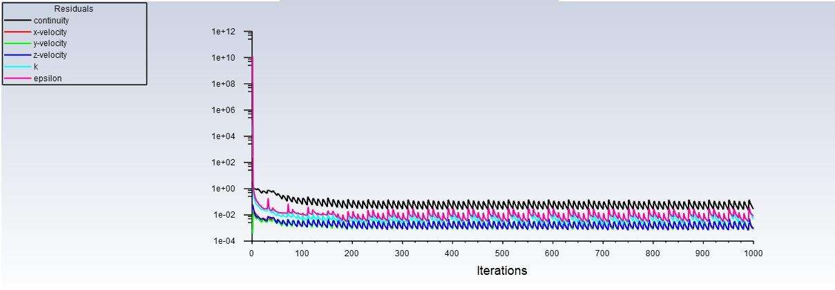
Computational Analysis
05
Force V/s flow-time Graph
Residuals at different Iterations

Slide 42
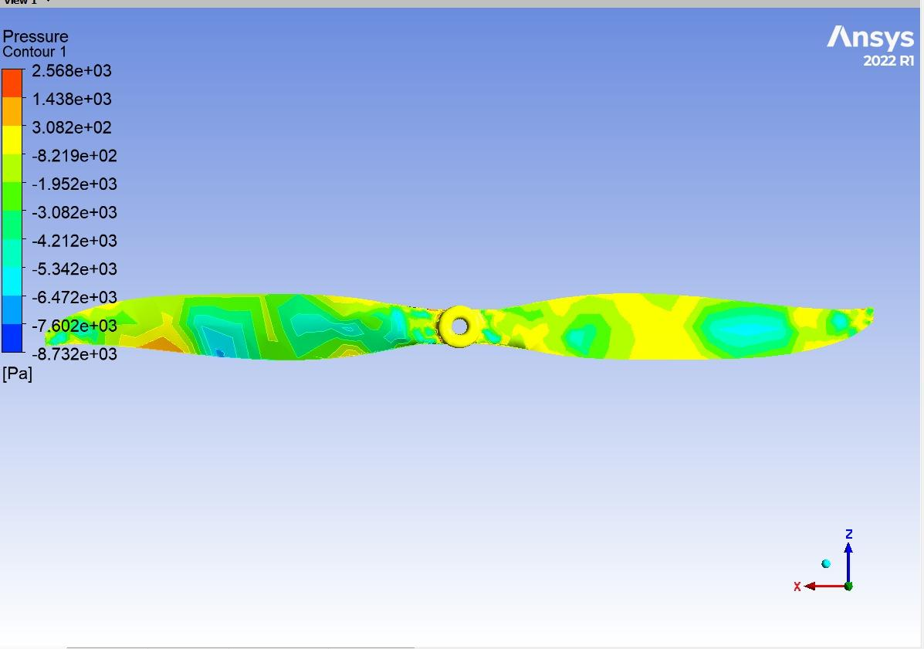
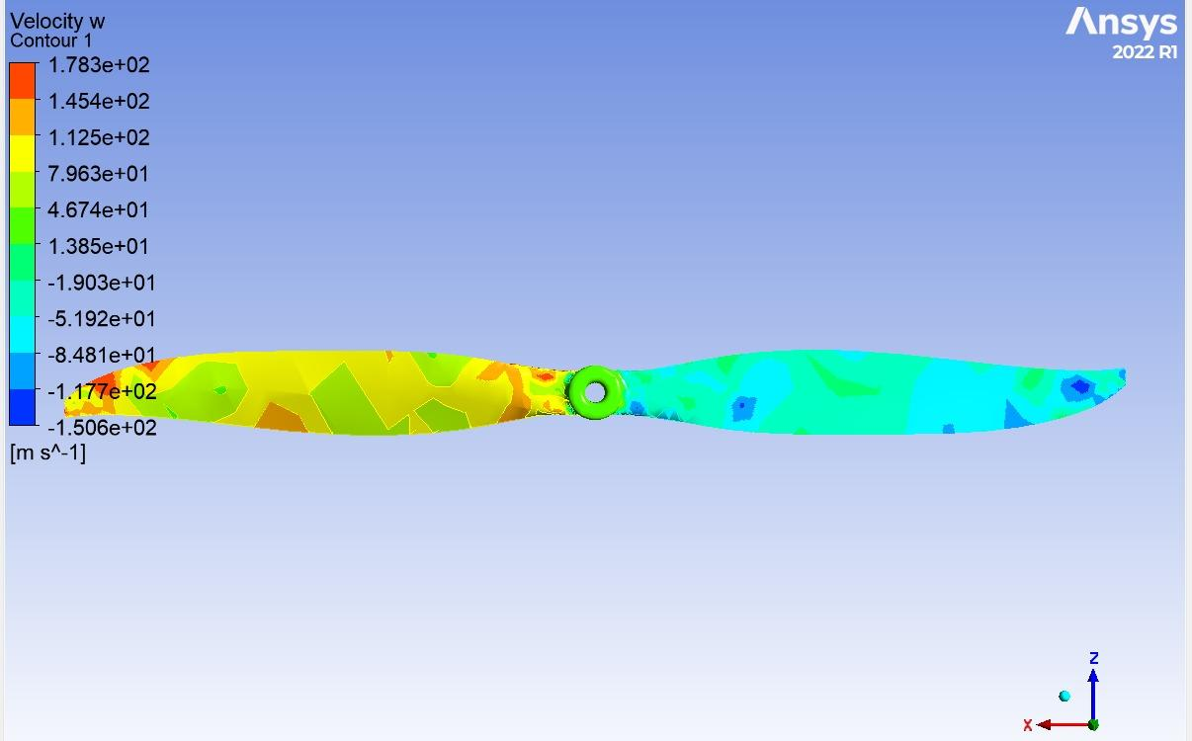
Computational Analysis
05
Pressure Contour
Velocity Contour

Slide 43
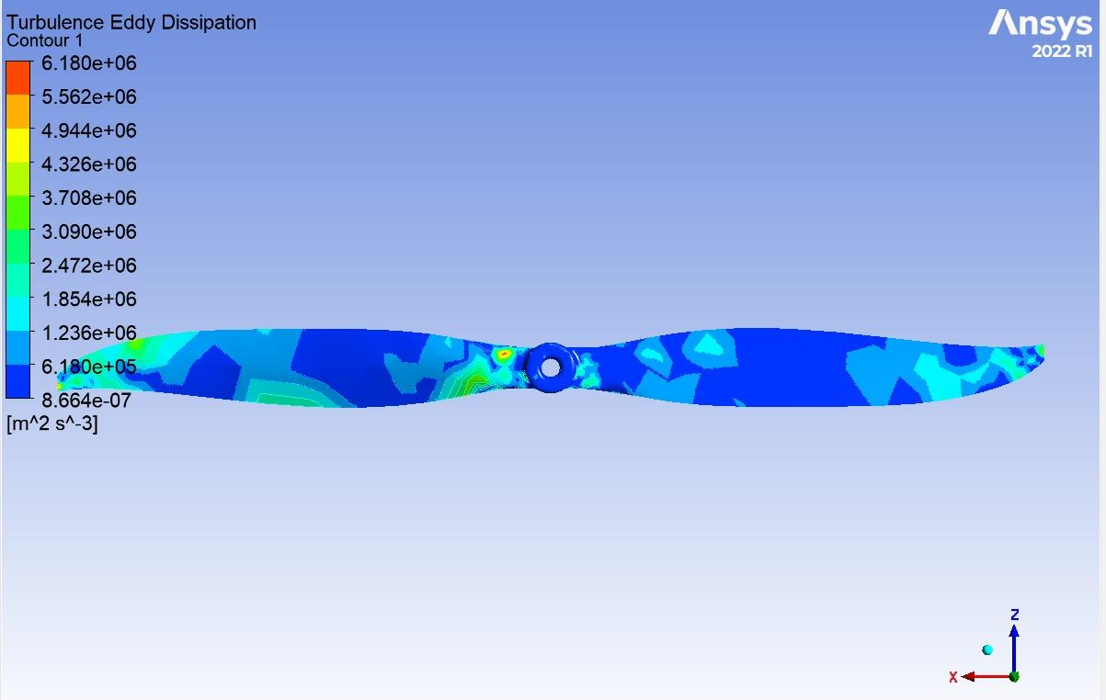
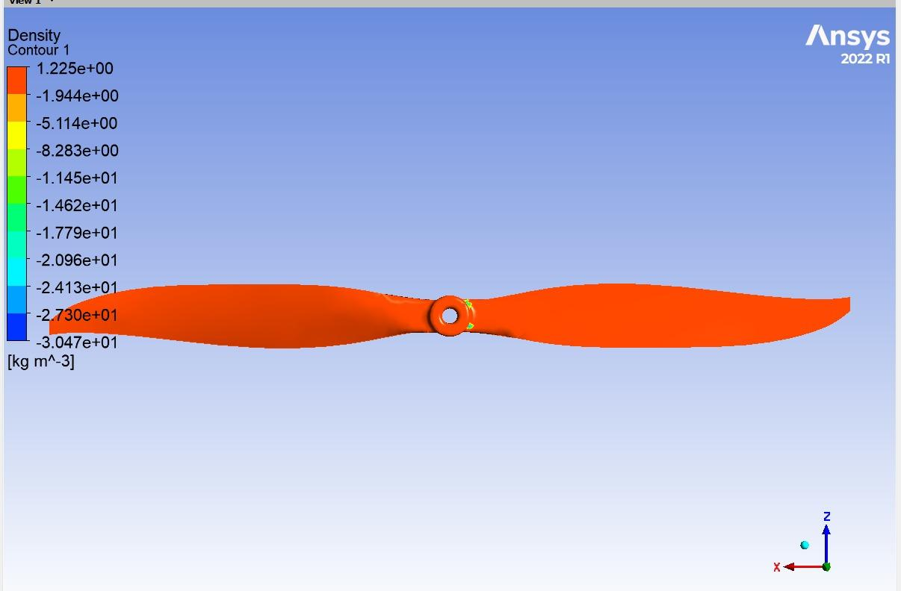
Computational Analysis
05
Turbulence Eddy Dissipation
Density Contour

Slide 44
Detailed Weight Breakdown
05
Part Name | Mass | Part Name | Mass
Lower Plate | 43.434 g | Motor | 31.757 g
Arm Strength Plate | 24.745 g | Motor Holder | 6.362 g
Arm | 174.102 g | CCW Propeller | 23.711 g
GPS Unit | 55.264 g | Camera Transmitter | 10.209 g
Arm Truss | 7.495 g | Receiver | 15.559 g
Upper Plate | 33.403 g | CW Propeller | 23.624 g
Battery Holder | 27.956 g | ESC | 13.214 g
Claw | 106.808 g | Camera | 18.196 g
Servo | 20.40 g | Lock Nut | 5.245 g
Telemetry | 9.132 g | Battery | 515.417 g
Screw Bolt | 5.195 g | Receiver | 15.559 g
Landing Arm Rubber Pad | 8.984 g | Pixhawk 6c | 59.724 g
Power Module | 30.139 g | GPS Mount | 36.398 g
Landing Arm | 42.968 g | Miscellaneous | 340 g

Slide 45
Thrust to Weight Ratio
05
Weight of the Drone = 1815.810 gm
Weight of the Payload = 200 gm
Total Weight of the Drone Including Payload = 2015.810 gm
Max Thrust Generated by each Motor = 2190 gm
Number of motors being used = 4
Total Thrust Generated by four Motors = 2190*4 gm = 8760 gm
Thrust to Weight ratio (T/W) = Total Thrust Generated / Total Weight
= 8760 / 2015.810
= 4.3
Advanced racing drones can achieve thrust-to-weight ratios greater than 5:1
Commercial camera drones typically have ratios ranging from 2:1 to 4:1

Slide 46

Operation Demonstration
05

Slide 47
Final UAV Specifications
05
Serial Number | Components | Specifications
1. | Motor | 1300 KV, 10,400 rpm - 4 Esc - 30 Ampere
2. | Propeller | 0.254 m ( 10.45 inch ) dia - 10 inch
3. | Flight controller | DJI , pixhawk, apm
4. | Radio transmitter | Flysky i6x - 1.5 km max range
5. | Reciever | fs ia6b

Slide 48
Future Plans
05
Research and Development
Through research and development to enhance drone capabilities.
Focus areas: sensor integration, flight control systems, payload capacities and autonomous navigation.
Collaboration with experts and leveraging cutting-edge technologies.
Software and Autonomy
Development of software systems for autonomous flight and mission planning.
Advanced algorithms for hotspot detection, flight path optimization and obstacle avoidance.
Goal: Increased autonomy and reduced human intervention.
Notes:
© Copyright Showeet.com – Creative & Free PowerPoint Templates

Slide 49
Reference Table
06
Reference | Used For
https://www.tytorobotics.com/blogs/articles/the-drone-design-loop-for-brushless-motors-and-propellers | Calculation Of Power Required
https://design215.com/dcal/toolbox/tubing-calculator | Arm Strength Analyzing
https://flyeval.com/ | Calculating Performance
https://www.omnicalculator.com/other/drone-motor | Drone Run TIme Estimator
https://grabcad.com/cadgrab-1 | Pre Made CAD Models of Brand Components
https://emaxmodel.com/products/pre-order-emax-eco-ii-series-2807-1300kv-1700kv-1500kv-brushless-motor-for-rc-drone-fpv-racing | Performance and specification table of motor
https://www.ecalc.ch/xcoptercalc.php | Performance Analyser

Slide 50

Thank You!

